Slide 1
the work was done by Komolkina Alexandra, Nafikov Vladimir, Sobolev Daniel, Madyar David.

Slide 2
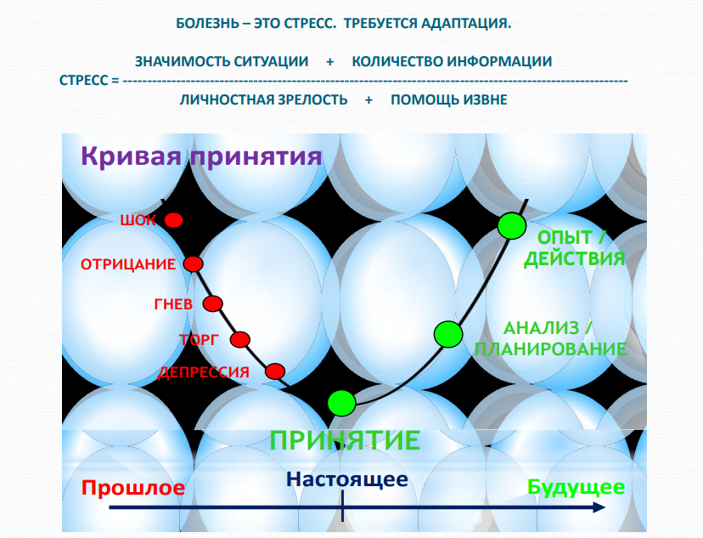

Slide 4
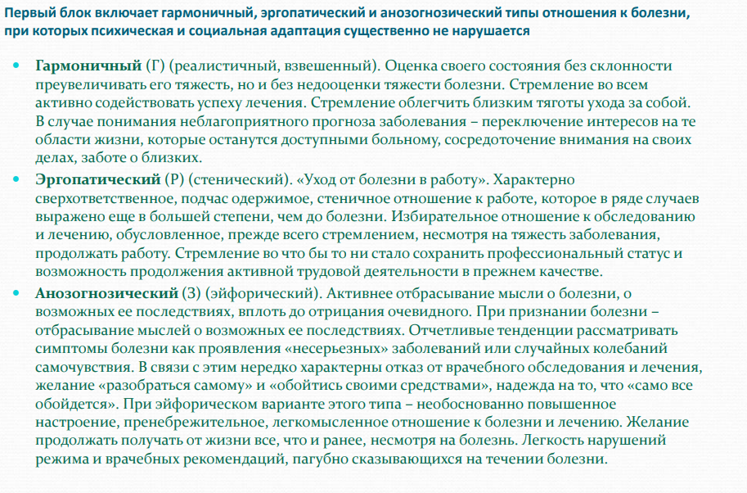

Slide 5
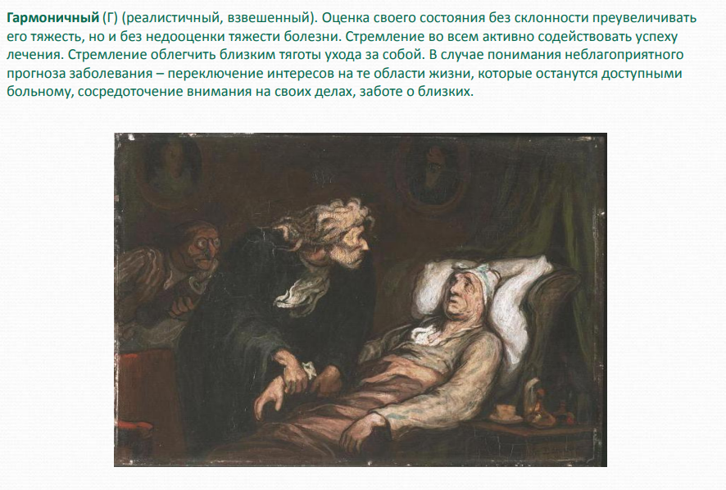

Slide 6
